Slide 1
RL in a Motorway environment: Deep Q-learning example
Stefano Sabatini

Slide 2

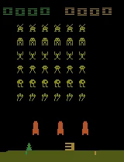
Introduction
Objective
MAIN OBJECTIVE:
Create a simple simulator to mimic an highway environment
Train an agent using RL techniques
Considering a BEV image (or multiple BEV images) as state opbservation
Different layers may encode different perception information (e.g. Obstacle history, obstacle speed, road structure etc...)

Slide 3
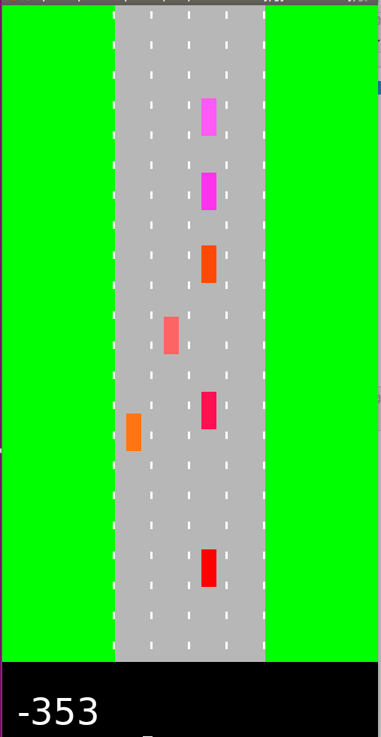
Environment
OpenAI gym environment
OPEN AI framwork to define the environment:
class FooEnv(gym.Env): metadata = {'render.modes': ['human']} def __init__(self): ... def step(self, action): ... def reset(self): ... def render(self, mode='human', close=False): ...
Longitudinal (accelerate, break
Dynamic of the system
Lateral (lane change left, lane change rigth)
State visualization
RGB image

Slide 4
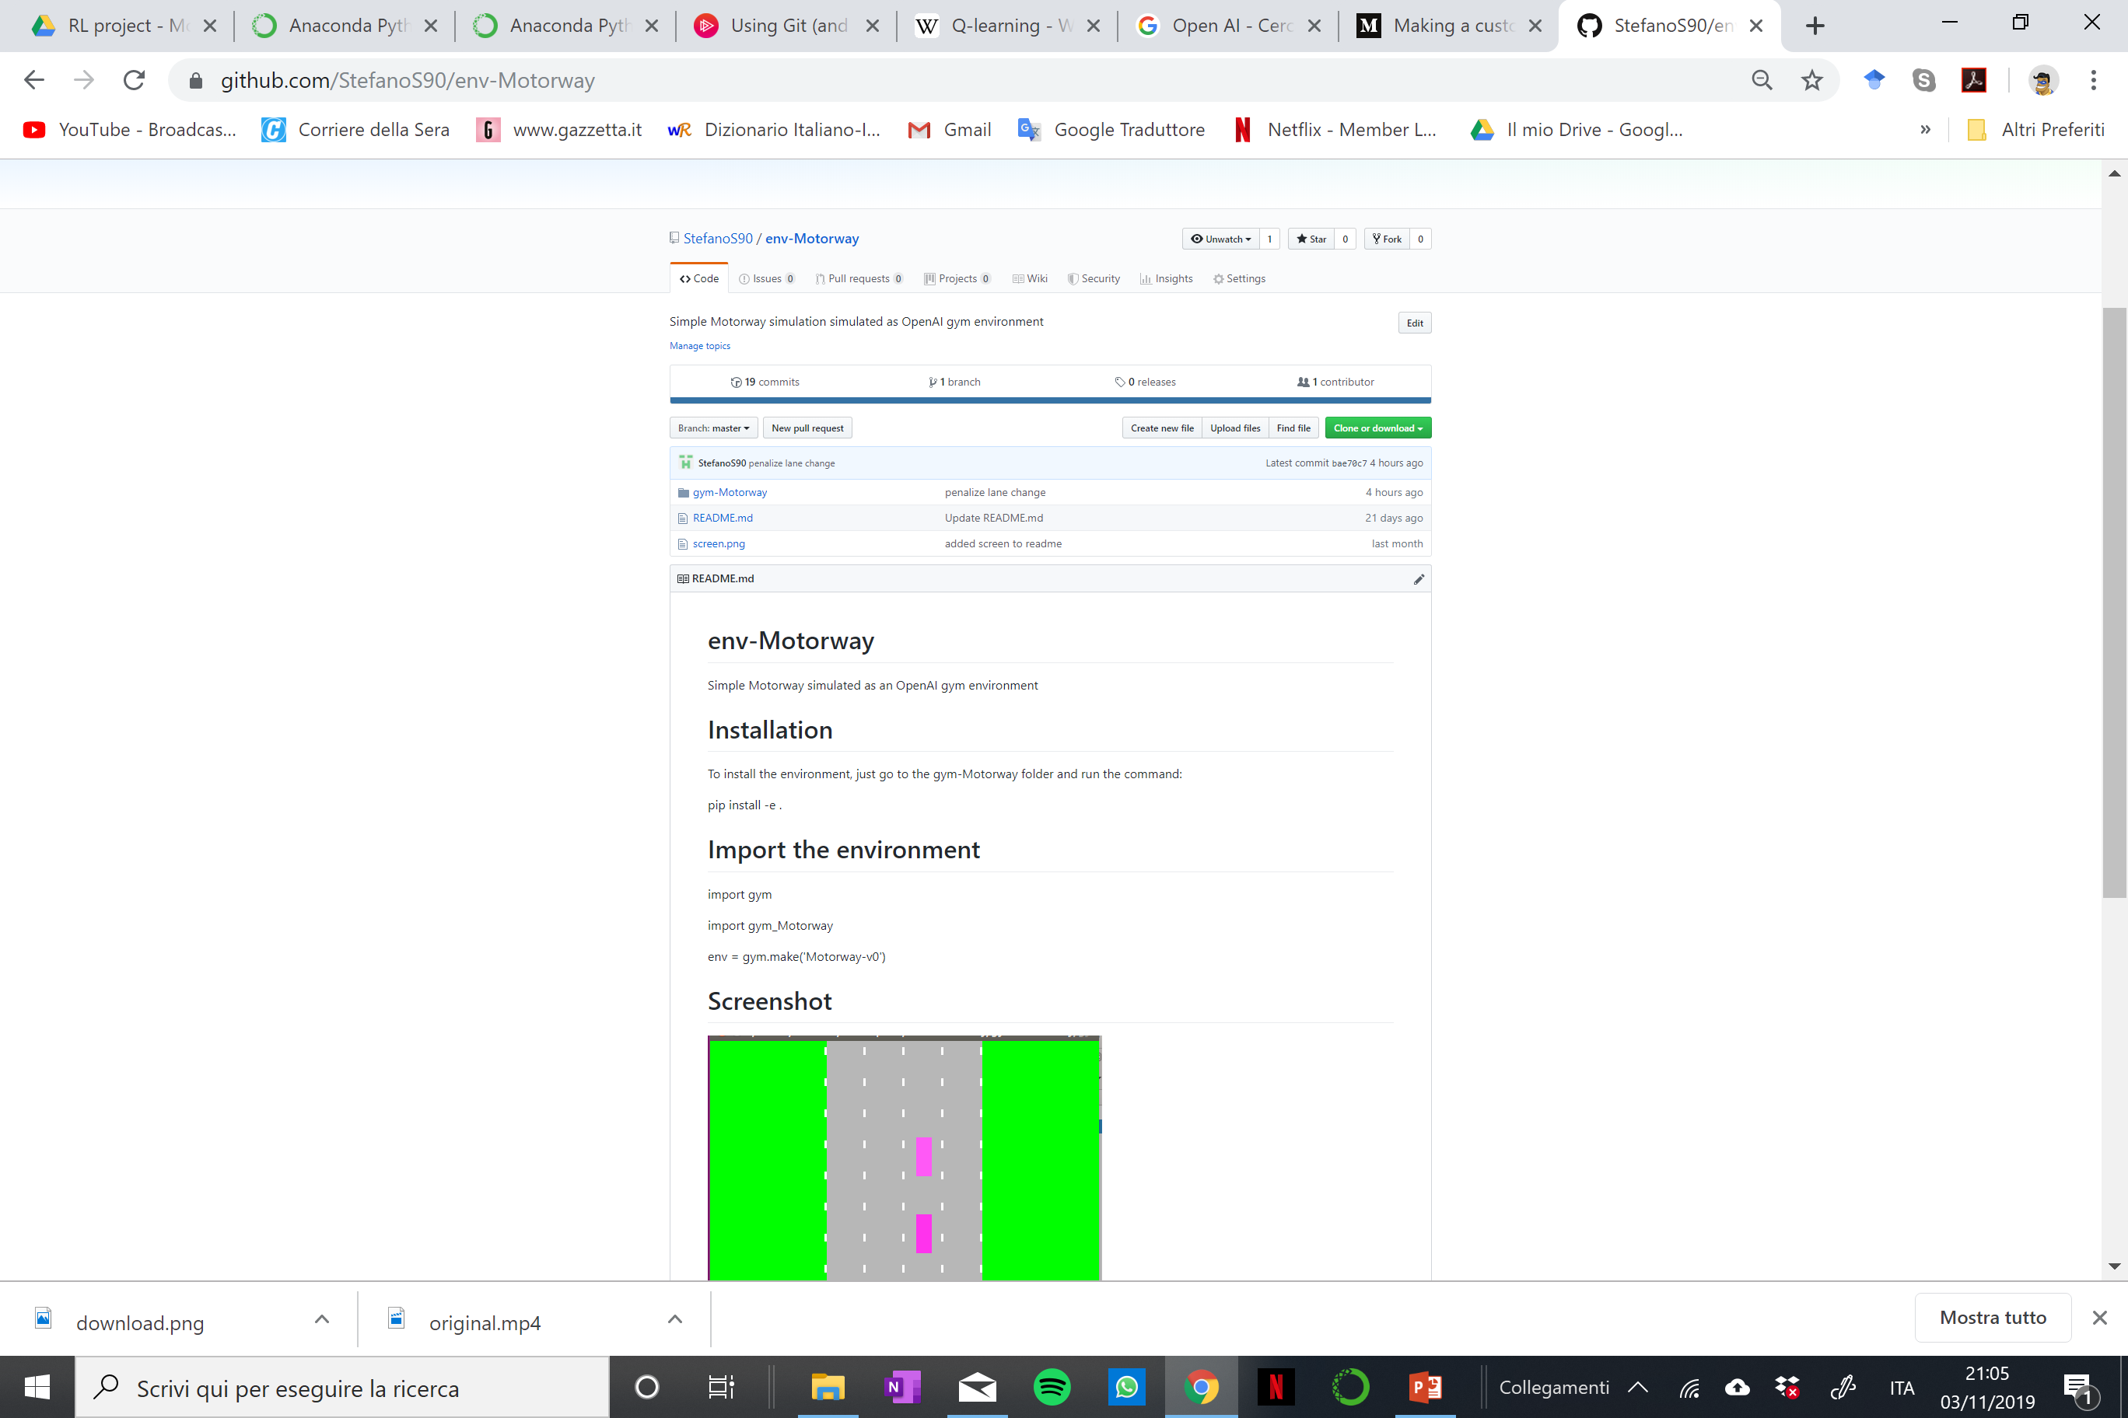
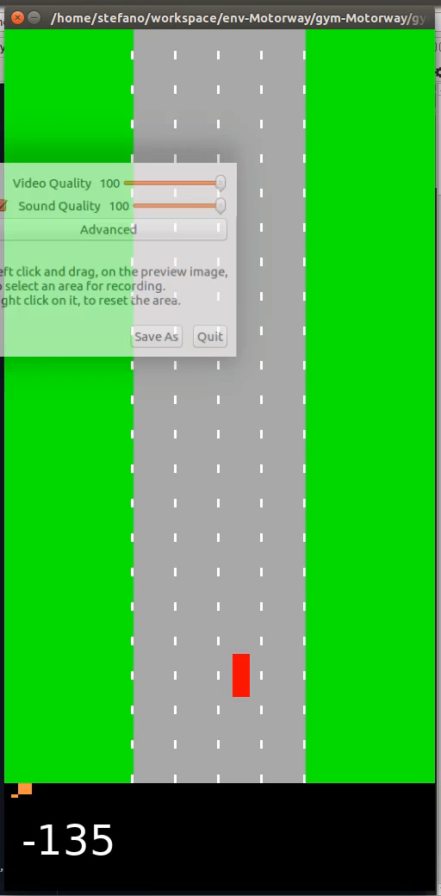
Environment
Motorway env

Slide 5
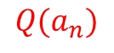
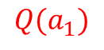

RL algorithm
Deep Q-learning
End-to-end learning of $Q\left(s,a\right)$ (the value of the action-state pair) from pixels $s$
Q (a,s)
value for each actions
$$Q(a_{1})$$
State
$s$
$$Q(a_{n})$$

Slide 6
Deep Q-learning
Mnih, Volodymyr, et al. "Human-level control through deep reinforcement learning." Nature 518.7540 (2015): 529.

Slide 7
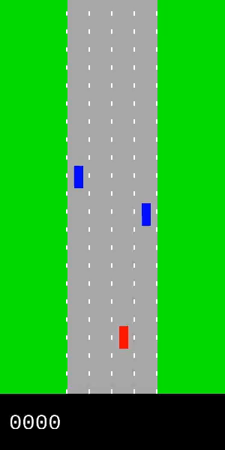
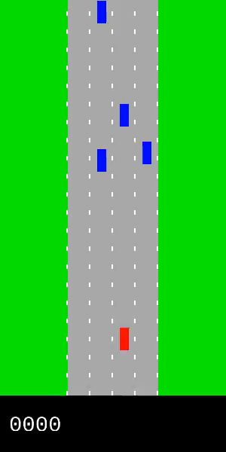
DQN on motorway
Partial Results
Episode 900
Episode 0

